Slide 1

Capstone Project- 1
EDA on Airbnb Booking
Team Name : Worker Bees Kiran Mahara(Team Lead)
Aman Gupta
Smriti Bhattrai

Slide 2
Presentation Outline
Problem Statement
Data Dictionary
Agenda
Insights
Conclusions
Challenges Faced

Slide 3
Problem Statement
In this project we analyzed Airbnb’s New York city (NYC) data of year 2019. NYC is not only one of the most famous city in the world but also top global destination for visitors drawn to its museums, entertainment, restaurants and commerce.
Airbnb is an American company that operates an online marketplace for lodging, primary
home stays, vacation rentals, and tourism activities.
Our main objective was to explore the factors like price, availability, room type, etc and how they vary among different rentals in New York. For this, we explored and visualized the dataset having thousands of rows from Airbnb in NYC using Exploratory Data Analysis (EDA) techniques which is a crucial factor for growth of the company.
We applied data analysis techniques on different features/attributes available in dataset to find out the insights on Airbnb listing based on their location, room type, price and other related factors.

Slide 4
Understanding the Data
There are near to 48,895 observations with various types of features in Airbnb dataset.
List of Features :
Id Name Host id Host name Neighborhood group Neighborhood Latitude Longitude | Room type Price Minimum nights Number of reviews Last review Reviews per month Calculated host listing count Availability_365

Slide 5
Understanding the Data (continued)
Data Dictionary
Id -Unique identifier for each row.
Name - Listing name which user sees while booking (hotel name).
Host_Id - Every host in Airbnb gets an unique id, host id represents that id only.
Host_name - Name of the host.
Neighborhood group - Whole New York is divided into 5 neighborhood group
(boroughs) regionally. This feature shows in which borough particular listing is Located.
6. Neighborhood - Each borough is further subdivided into neighborhoods. This feature shows in which neighborhood particular listing is located.

Slide 6
Understanding the Data (continued)
Data Dictionary (continued)
Latitude and longitude -These shows geographical location of a listing.
Room_type - The type of room rental is offering ( private, shared , entire home).
Price - Price per night that a rental is charging.
Minimum_nights - Minimum number of nights for which rental can be booked.
Number_of_reviews - Number of reviews rental has got till now.
Reviews_per_month - An average number of reviews a rental got per month.
Last_review - Date on which a rental got its last review.
Calculated_host_listings_count - Number of rentals a host is hosting in the dataset.
Availability_365 - Number of days for which a rental is available to book.

Slide 7
Agenda
By analysing and visualizing the data, we tried to answer following questions for
Airbnb:
Visualizing and analysing about different areas(neighbourhood and boroughs).
How hosting is divided among these boroughs ?
What is the number of neighborhoods each borough have ?
Some of the top neighborhoods and to which borough they belong?
What is the price distribution in each borough ?
How does an average price varies in each borough ?
How does an average price varies in each neighbourhood?

Slide 8
Agenda (continued)
Visualising and analysing about different room types.
What is the total number of rentals for each room type ?
How room types are divided in each borough ?
How does prices distributed among these room types ?
Whether every borough have a nearby same average price range or it differs ?

Slide 9
Agenda (continued)
Visualising and analysing about hosts.
Find top 10 hosts with most listings.
How calculated host listing count is distributed ?
In which borough and neighborhood these top 10 hosts have most of their
hostings.

Slide 10
Agenda (continued)
Visualising and analysing about prices.
Does minimum nights have any effect on price ?
Relation between price and availability 365.
Relation between price and number of reviews.

Slide 11
Agenda (continued)
Visualising and analysing about availability_365.
Distribution of availability
How availability varies with different boroughs.
How availability varies with different room types.

Slide 12
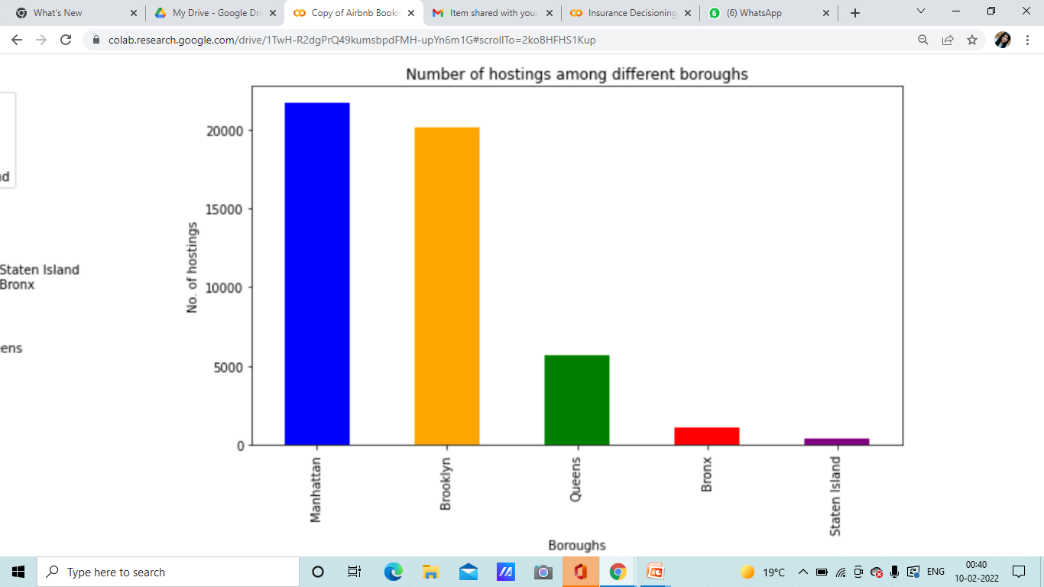
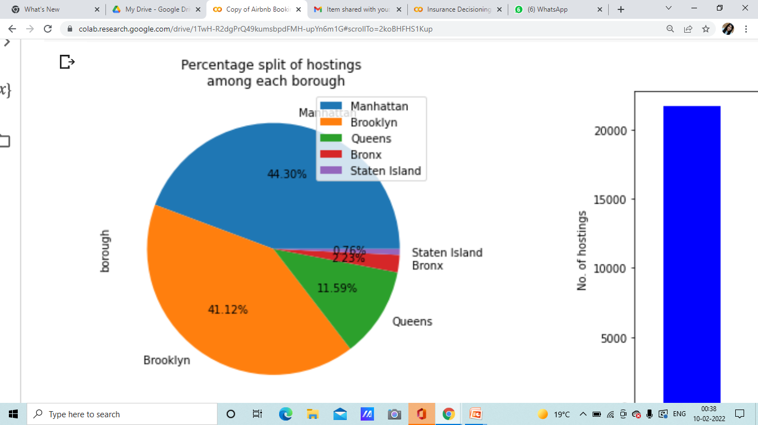
Hosting divisions among these boroughs
Around 44.3% hostings are from Manhattan and
41.12% hostings are from Brooklyn.

Slide 13
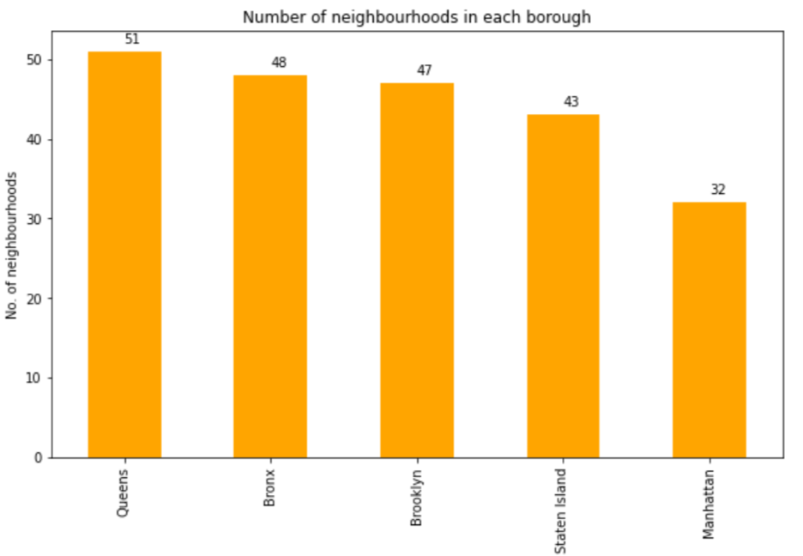
Number of neighborhoods in each borough
Although Manhattan and Brooklyn
have most no. of hostings but
in terms of neighborhood they
are quite back.
Queens have maximum number of
boroughs and Manhattan has the least.

Slide 14
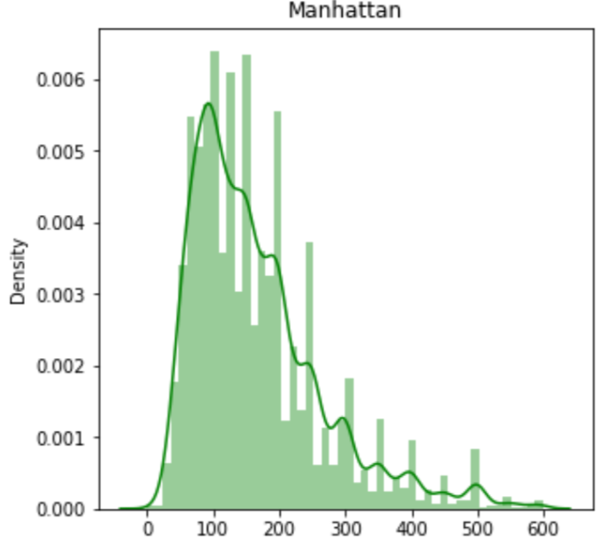
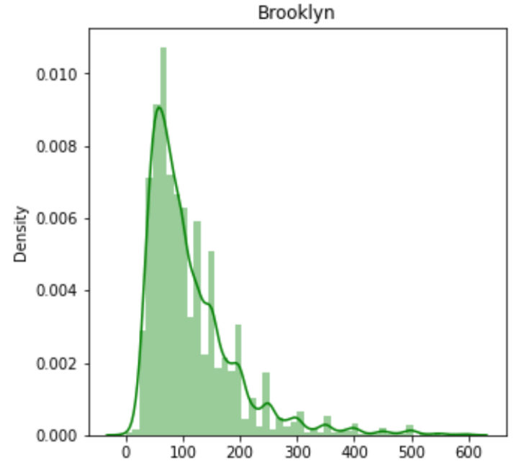
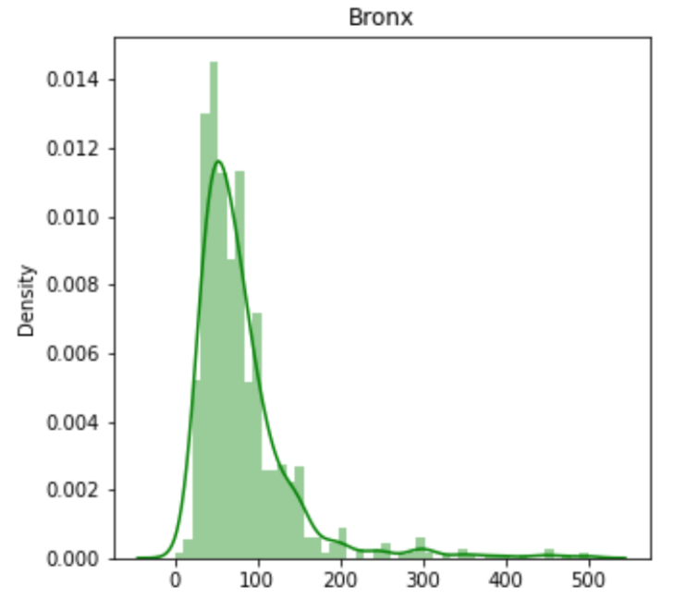
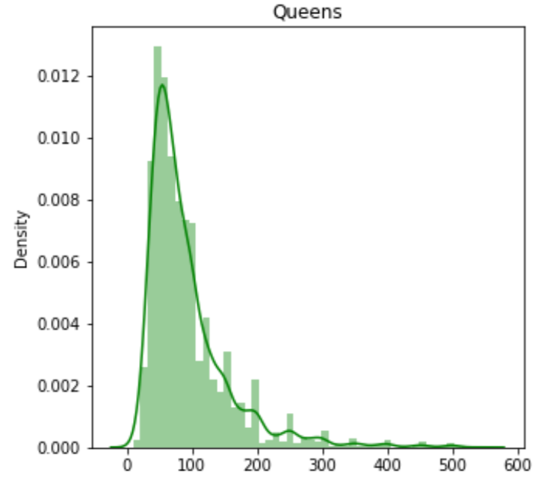
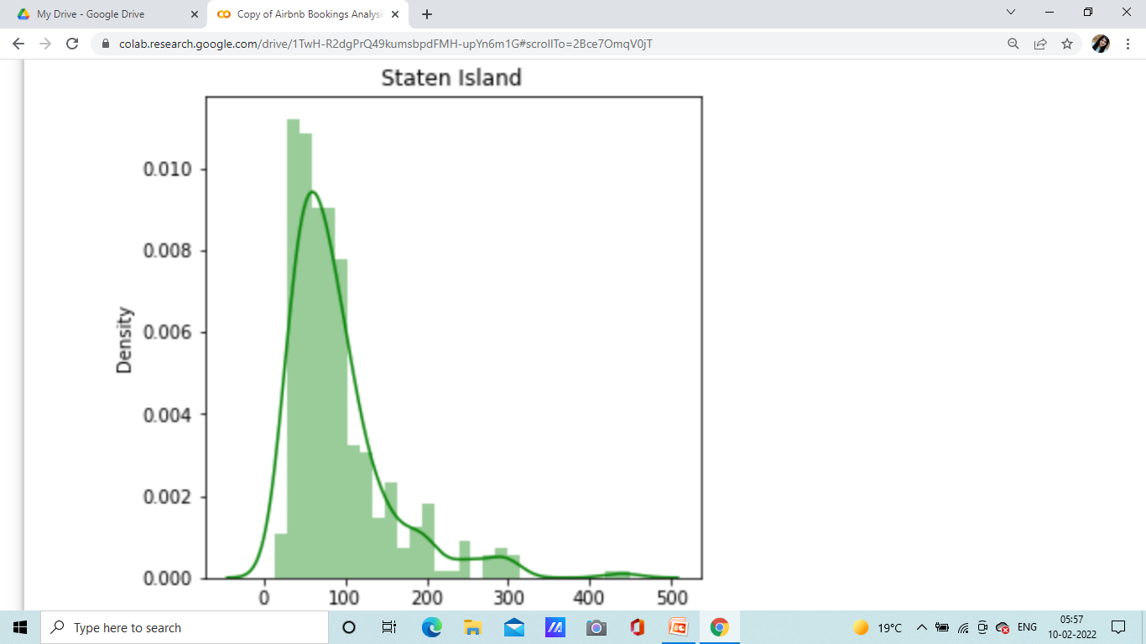
Price distribution in each borough
We have done outlier treatment here for price by setting up maximum value of price to be 600 and even after removing outliers still the data is bit skewed. We can further decrease the threshold of price also.
Almost every borough has same starting price values only difference is in ending range of prices
For Manhattan price range mostly ends near 400-500 approx.
For Brooklyn price range mostly ends between 300-400 approx.
For Bronx its quite low and somewhere ends near 200-250.
Staten Island and Queens is quite similar and is somewhere ends up
nearby or less than 300.

Slide 15
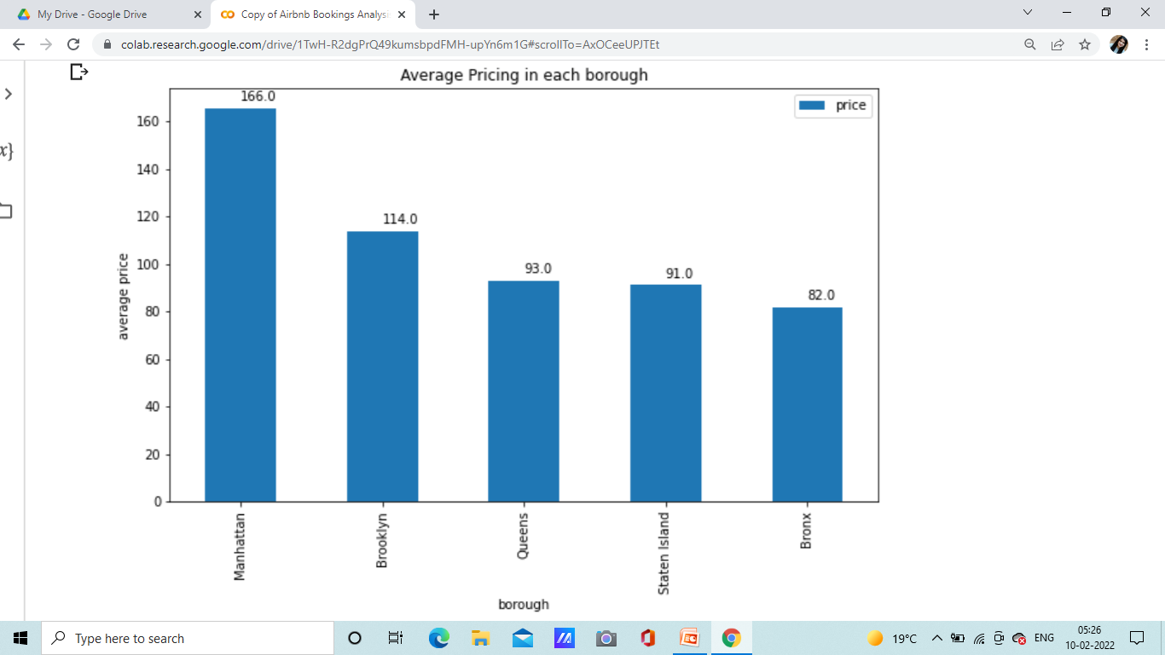
Average price of rentals in each borough
Manhattan is one of the borough that
charges quite high for hostings
followed by Brooklyn.
Queens and Staten Island has nearly
same average price for hostings.
Note – We have only considered the
Rentals having price <600

Slide 16
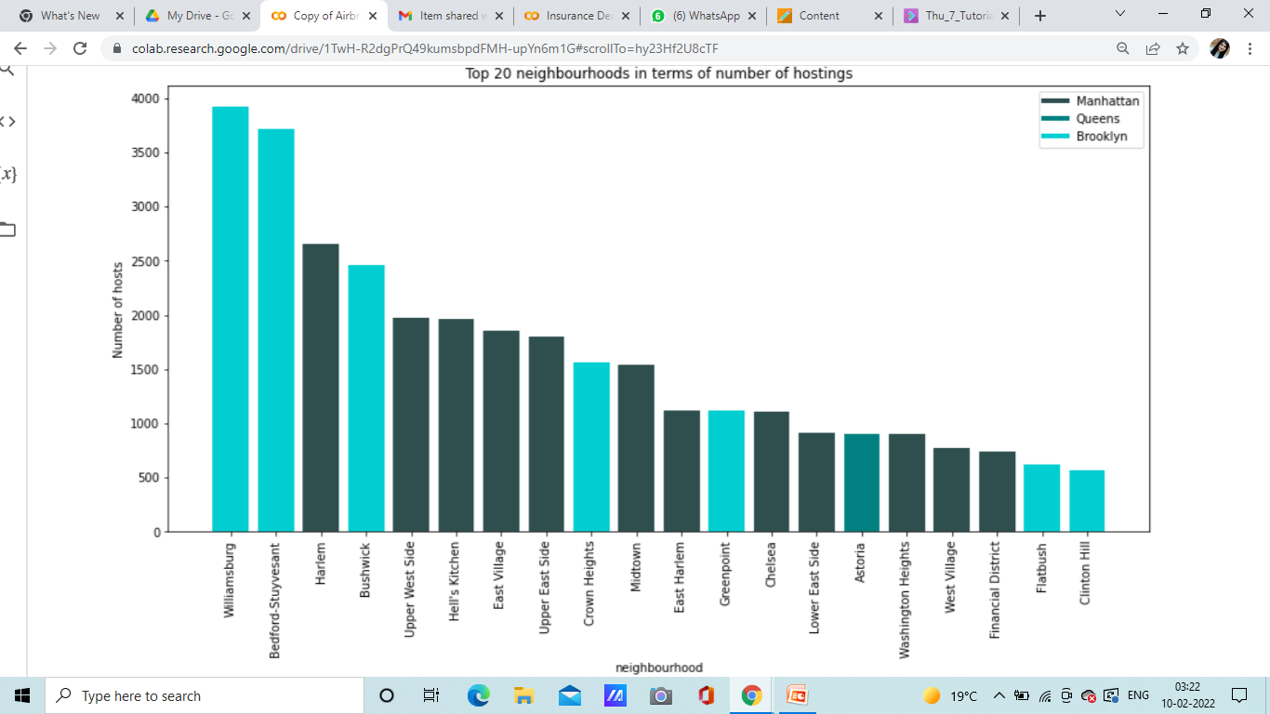
Some of the top neighborhoods and borough
they belong to
Among top 20 neighborhoods
most of these neighborhood
belongs to Manhattan borough.
Although If looking for top 3
densely hosted neighborhood
top 2 belongs to Brooklyn.
Only one neighbourhood of
Queens is in top 20.

Slide 17
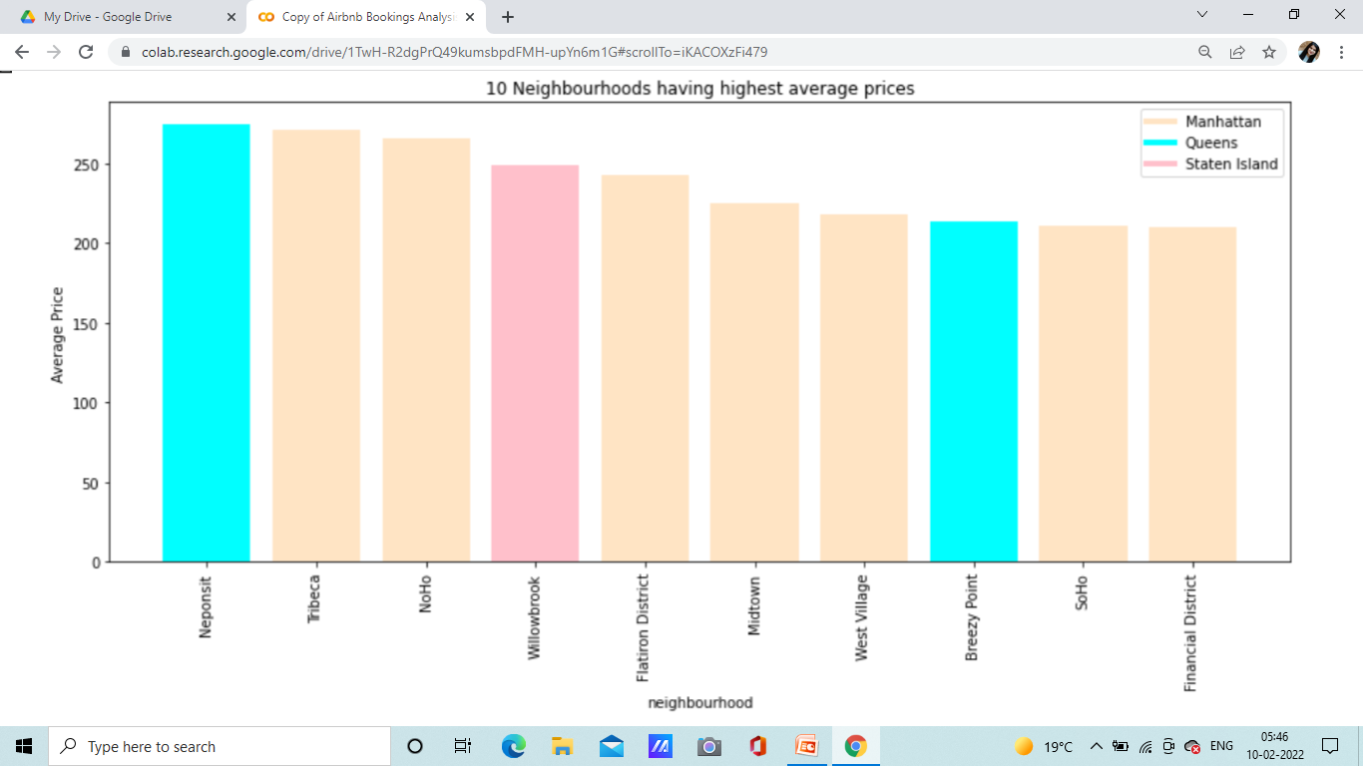
Top 10 neighborhood
with highest rental charges
We did similar outlier treatment here
for price.
Manhattan neighborhood seems to
have some of the top chargeable rentals.
In top 10 high chargeable rentals,
7 belongs to Manhattan.
Although Manhattan has 7 high chargeable
rentals but average charge of rental from
Queens neighborhood is in top.

Slide 18
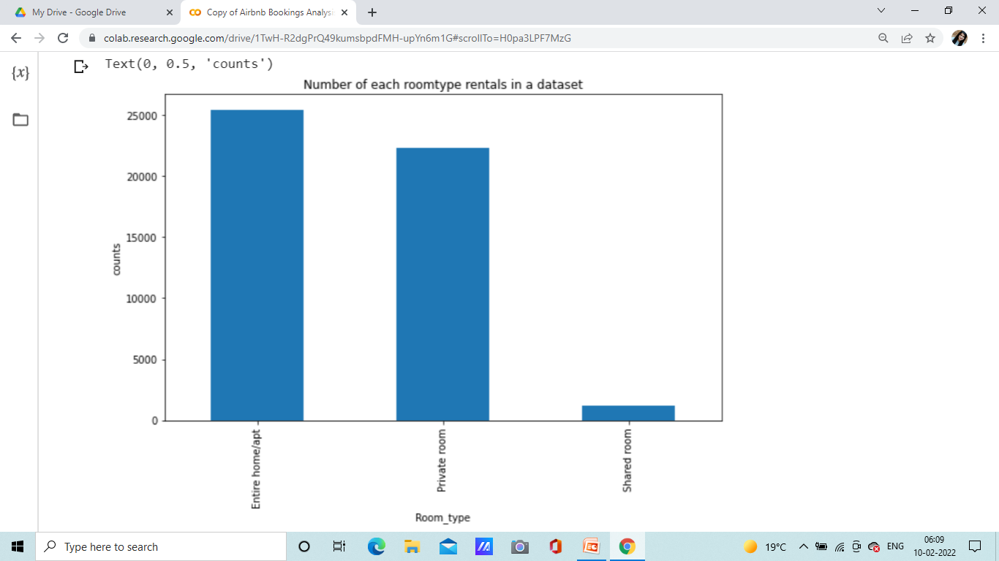
Counts of each room type
Mostly rentals are there for entire home or private rooms.
Just very few rentals in case of shared room.

Slide 19
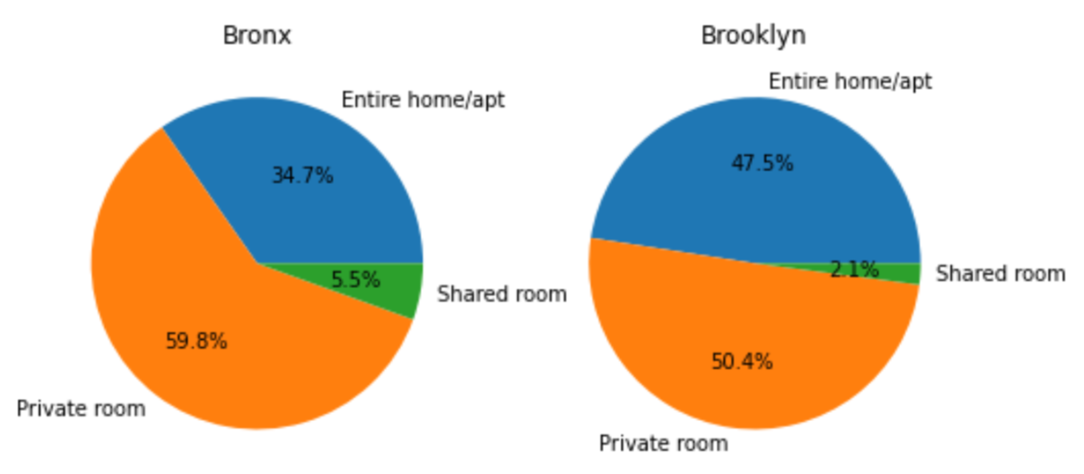
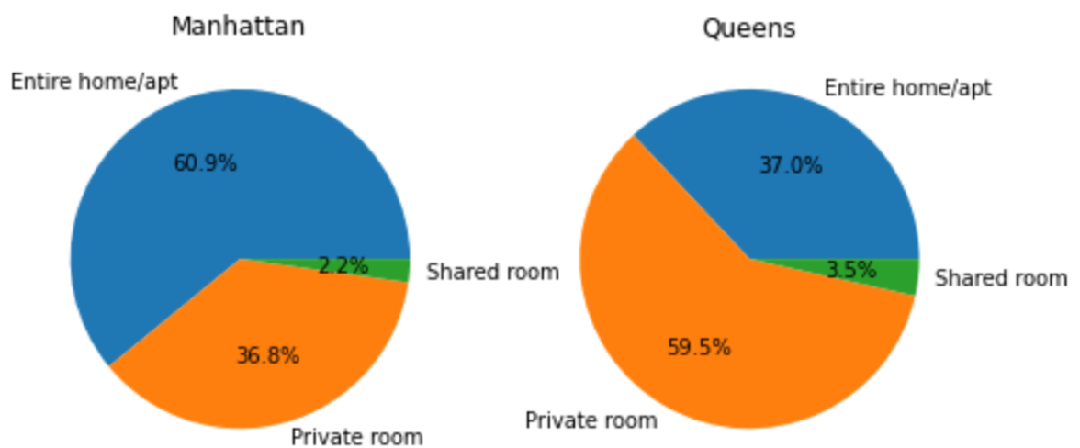
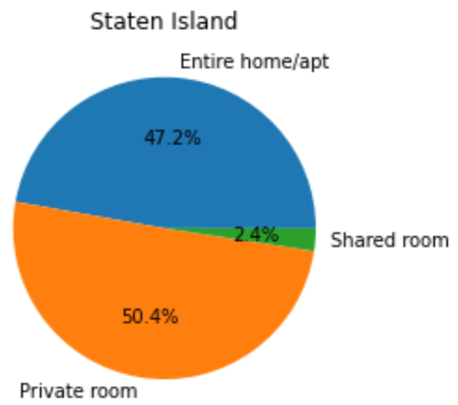
Percent Split of Room types in each borough
In each borough shared room is very negligent.
One thing noticeable is that among all boroughs only
Manhattan has more number of entire home than private rooms.
Other than Manhattan in each borough private room takes up that
place.

Slide 20
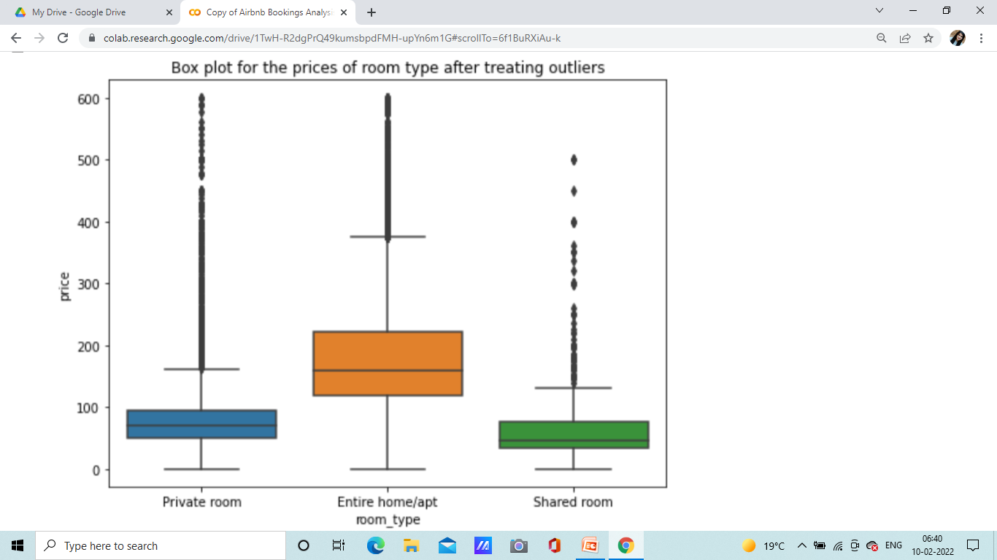
Prices distributed among these room types
Although we removed whole lot outliers but some are still there.
For entire apartments
Median or an average : 160-170
For private rooms
Median or an average : 70-80
For shared rooms
Median or an average : 50-60.

Slide 21
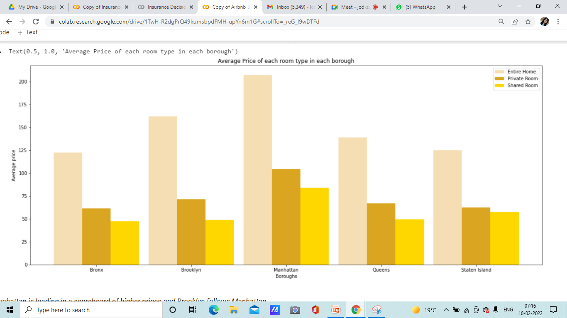
Average price of different room types
in each borough
Manhattan is leading in a scoreboard
of higher prices for each room type
and Brooklyn follows Manhattan.
Average price of private and shared room
is lowest in Bronx and Staten Island.
Average prices of private room is almost
same in Brooklyn and Queens.
Average price of shared room is almost
same in Bronx, Brooklyn and Queens.
Note – Threshold of price < 600 has been set.

Slide 22
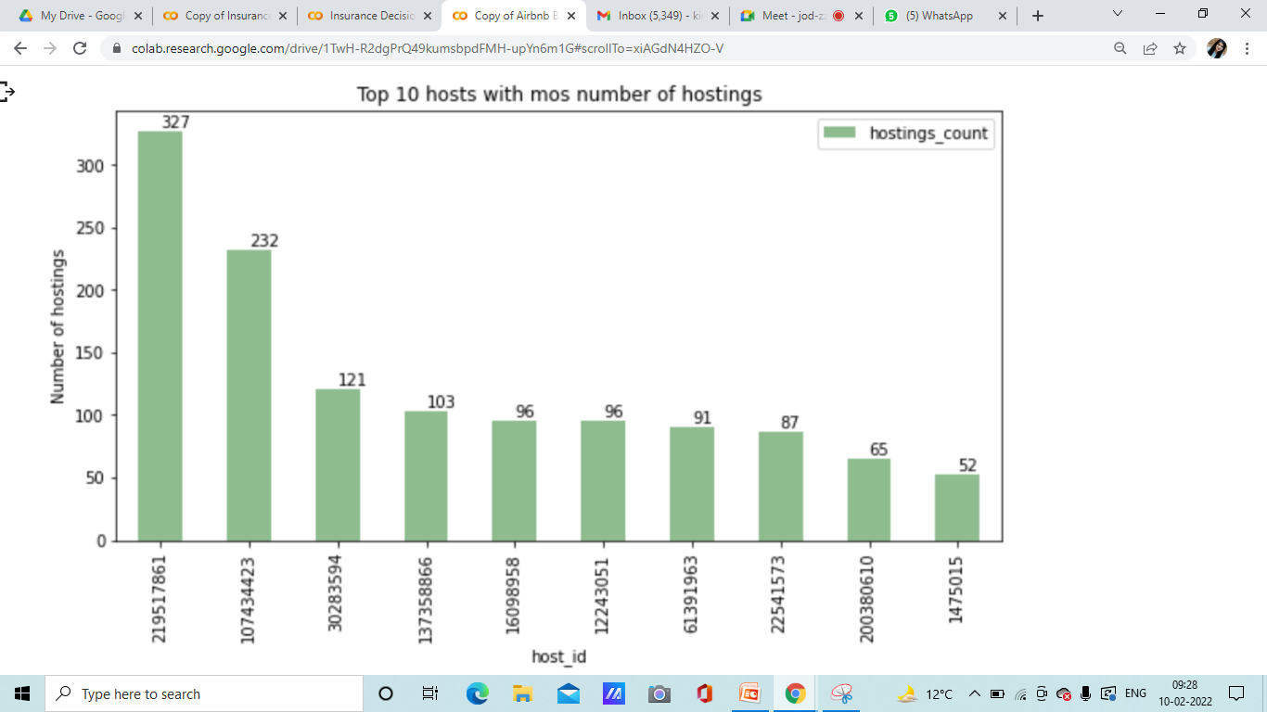
Top 10 hosts with most rentals.
There is a steep decrease in each for top 3 host counts and also they have too many hostings in it.
Highest number of hostings is 327.

Slide 23
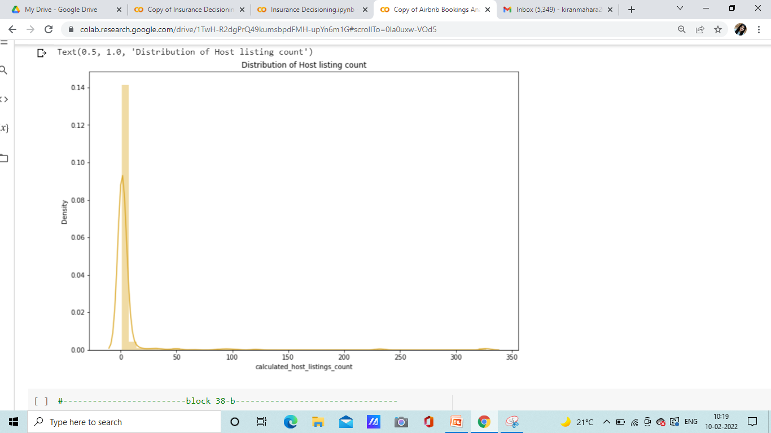
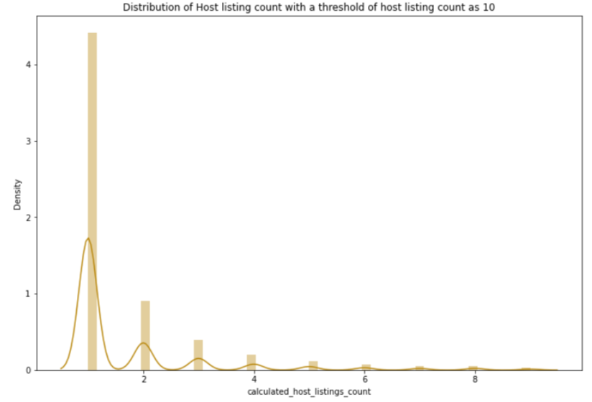
Calculated host listing count distribution
Most host has single rentals only. Although there are also such host having rentals as high as 327, then in 200s, 100s and 50s but general population in our dataset has 1 only.
Most host has only 1 rentals thus a value of calculated host listing count as 1.

Slide 24
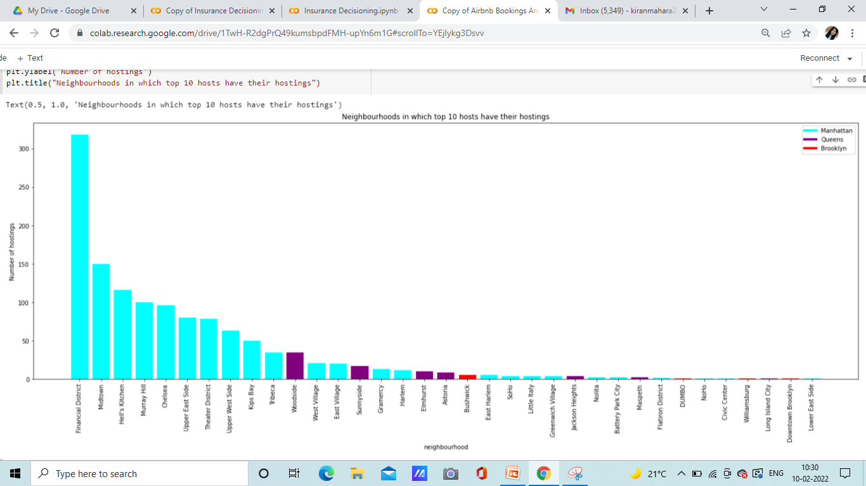
Borough and neighborhood
of these top 10 hosts
We can see that top and major neighbourhoods comes under Manhattan .

Slide 25
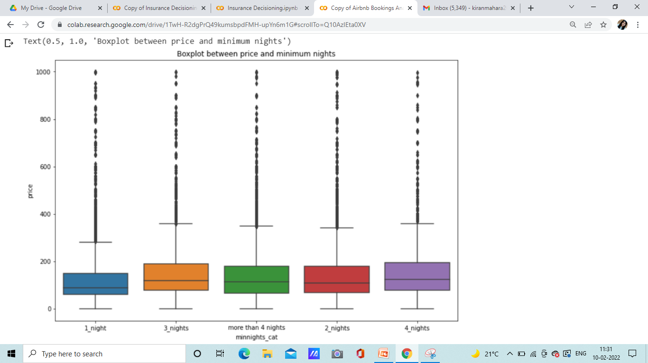
Minimum nights and their effect on price
In 49k rows we only had 109 unique
values. We tried categorizing it
to see if we can get any information
out of it.
We got to know that we can
divide our minimum night into
categories as 1 night,2 night, 3 night,
4 nights, more than 4 nights.
.

Slide 26
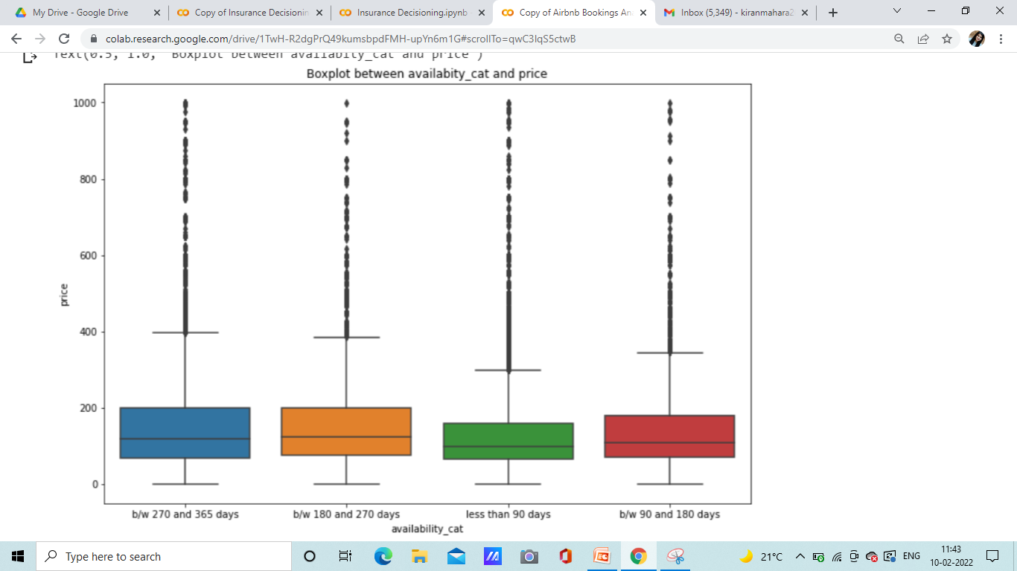
Relation between price and availability 365
Rental having less availability
(lesser than 90 days) are the
cheapest ones) whereas
between 180 and 270 days and
between 270 and 365 days
charges nearly similar and are expensive
ones.

Slide 27
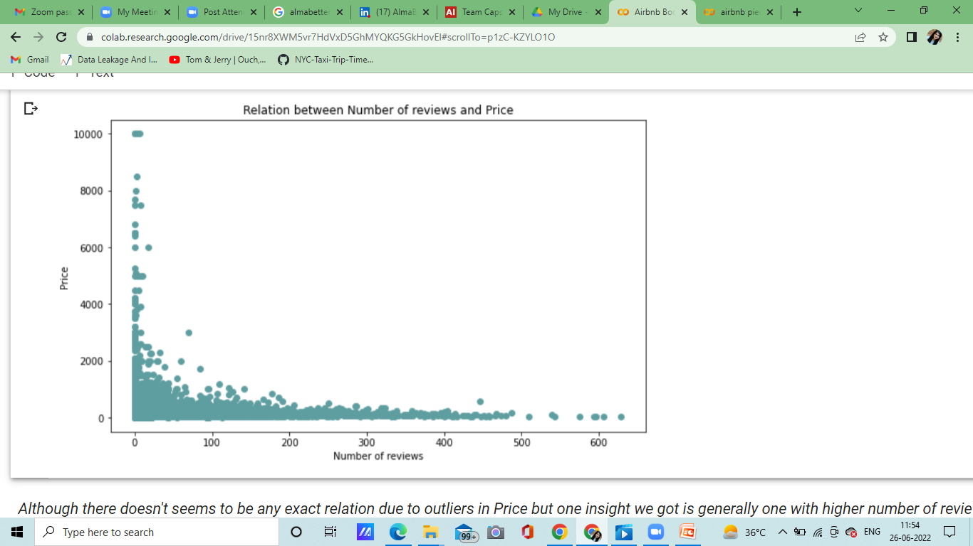
Relation between Price
and
Number of Reviews
Although there doesn't seems to be any exact relation due to outliers in Price but one insight we got is generally one with higher number of reviews have lower prices.

Slide 28
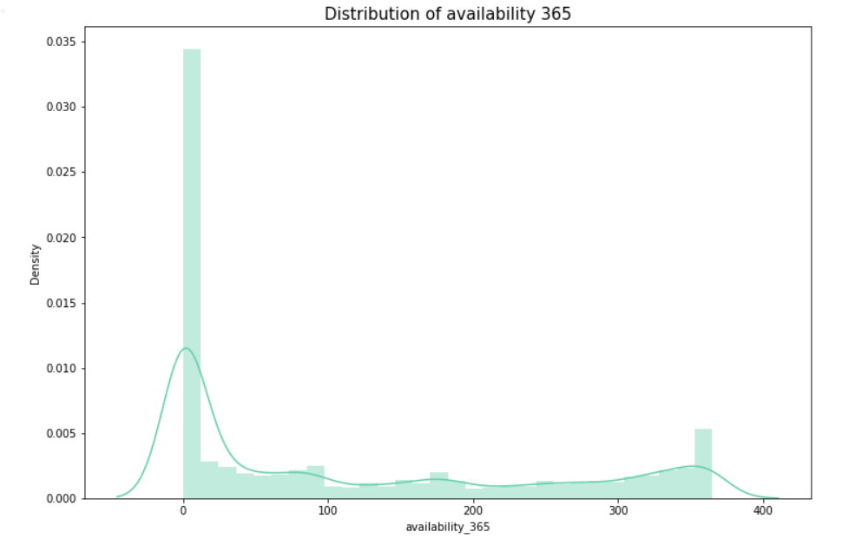
Distribution of availability 365
Most of them have availability less than 0-30 days.

Slide 29
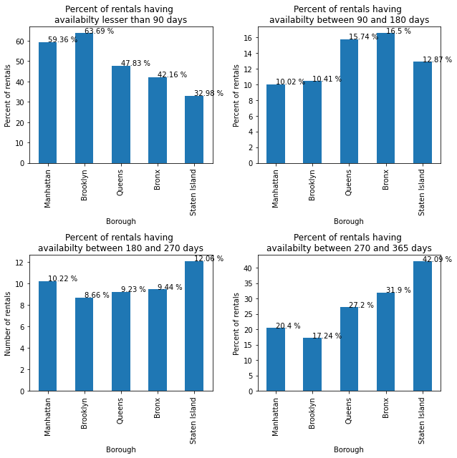
Percentage of Rentals of each Borough
in different availability categories

Slide 30
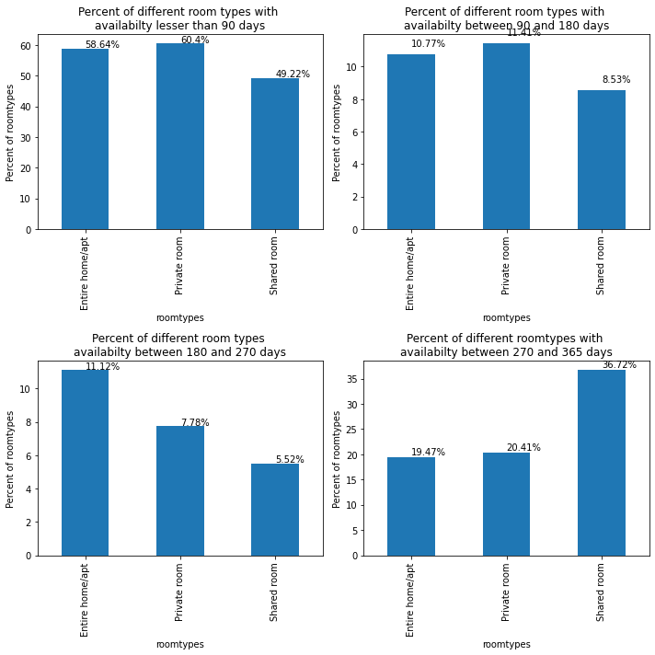
Percentage of different room types
in different availability categories

Slide 31
Conclusion
Manhattan and Brooklyn attracts most tourists and that’s why have most rentals. So the hosts looking for a best borough to have rental should go for Manhattan and Brooklyn.
In neighbourhoods Williamsburg have most number of rentals, whereas among top 20 neighbourhoods in terms of number of rentals most of them belongs to Manhattan
(12 out of 20).
Price of rentals has very high range. We have rentals that charges as high as 10000 as well but if we see on an average most of our rentals have their prices under 300.
Manhattan is most expensive borough in each of the room types.
Customers respect privacy and mostly prefer private rooms and apartments. So there are very minute availability of shared rooms as compare to private and entire homes.

Slide 32
Conclusion (continued)
Manhattan is the only borough to have more number of entire homes than private rooms. Assumption is that people might visits there with family or friends and prefer to have entire homes than private room.
Most of hosts only have one rentals but at the same time there is a host with host ID 219517861 manages 327 rentals and is one of the busiest host. He have all his rentals located in Manhattan.
More than half of the rentals of Manhattan and Brooklyn have availability lesser than 90 days. This suggests that Manhattan and Brooklyn rentals are heavily booked.
In terms of room types Entire home and Private Room are heavily booked as compare to shared room and also private room and entire home nearly have same availabilities.

Slide 33
Challenges
Understanding the meaning of some of the features.
For understanding some of the features we had to learn about New York city.
For understanding the dataset we had to understand the business model of Airbnb that how they work.
Handling missing values and working with outliers.
Designing some visualizations to summarize the information in the dataset.

Slide 34
Thank You

